Slide 1
Robot Locomotion

Slide 2
Introduction to Robot Locomotion
Robot locomotion refers to how robots move in their environment.
Key systems include mechanical structure, sensors, actuators, and control algorithms.
Main locomotion types: wheeled, legged, tracked, and hybrid.

Slide 3
Robotics Locomotion Scheme
Defines how a robot generates motion and controls movement.
Includes mobility mechanism, power transmission, and motion control.
Designed based on terrain and task requirements.

Slide 4
Core Locomotion Concepts
Important factors in locomotion design:
Stability
Maneuverability
Controllability
Energy efficiency
Terrain adaptability

Slide 5
Characteristics of Locomotion
Speed - Maximum travel velocity
Energy consumption - Power needed for motion
Stability - Resistance to tipping
Mechanical complexity - Number of moving components
Terrain capability - Ability to handle obstacles

Slide 6
Legged Locomotion
Robots move using articulated legs.
Examples - quadrupeds, hexapods, humanoid robots.
Advantages - good for rough terrain.
Disadvantages - high complexity and control requirements.

Slide 7
Legged Robot Gaits
A gait defines the pattern of leg movement.
Examples - walk, trot, run.
Control algorithms coordinate leg movement and balance.

Slide 8
Wheeled Locomotion
Most common locomotion type in mobile robotics.
Advantages - simple design, energy efficient, high speed on flat surfaces.
Limitations - poor performance on rough terrain.

Slide 9
Standard Wheel Configurations
Common wheel configurations
Differential drive
Tricycle drive
Ackermann steering – each wheel turns at different angle
Omni-directional wheels

Slide 10
Differential Drive Kinematics
Robot uses two independently driven wheels.
Linear velocity: v = (vR + vL)/2
Angular velocity: ω = (vR − vL)/L
L = distance between wheels.

Slide 11
Mapping Wheel Rotation to Velocity
Wheel velocity calculation: v = r × ω
r = wheel radius
ω = wheel angular velocity
Used to determine robot linear movement.

Slide 12
Robot Motion on a 2D Plane
Robot pose defined as (x, y, θ).
Motion equations.
dx/dt = v cos θ
dy/dt = v sin θ
dθ/dt = ω

Slide 13
State Representation
Robot state vector: [x, y, θ].
Used in localization, navigation, and control algorithms.
Sensors estimate robot state during movement.

Slide 14
Path Planning Overview
Path planning computes route from start to goal avoiding obstacles.
Uses grid maps or graphs.
Key steps - map environment, detect obstacles, compute path.

Slide 15
A* Path Planning Algorithm
Evaluation function: f(n) = g(n) + h(n)
g(n): cost from start
h(n): heuristic estimate to goal
Common heuristic - Manhattan distance.

Slide 16
Differential Drive Simulation Model
Robot position updated using
x = x + v cos θ dt
y = y + v sin θ dt
θ = θ + ω dt
Used in mobile robot simulators.

Slide 17
Applications of Robot Locomotion
Autonomous vehicles
Warehouse robots
Delivery robots
Planetary exploration rovers
Service robots

Slide 18
Programming Mobile Robot Locomotion
Software pipeline:
Sensors → Localization → Path Planning → Motion Control → Motors
Often implemented using Python or C++.

Slide 19
Summary
Robot locomotion integrates mechanics and control algorithms.
Key topics - wheel kinematics, motion modeling, and path planning.
These concepts enable autonomous mobile robots.

Slide 20
Locomotion - A Programmer's Perspective
Understanding the Hardware You'll Control

Slide 21
Welcome – What This Means for You as a Programmer
You're not building motors – you're commanding them
Your Code ──► Commands ──► Hardware ──► Motion ──► Sensors ──► Data ──► Your Code
↑ ↑ ↑ ↑ ↓
What you The "muscle" What What tells Feedback
send you control happens you what loop closes
happened
Understand the hardware well enough to write great control code
Analogy:
You don't need to build a car engine to drive well
But you do need to know: gas pedal, brake, steering wheel, and how the car responds

Slide 22
Motors
In mobile robotics locomotion, PWM (Pulse Width Modulation) and encoders work together to control and measure the motion of DC motors.
PWM controls the motor speed, while the encoder measures the actual rotation of the motor shaft, allowing precise motion control.

Slide 23
DC Motor in Robotics Locomotion
A DC motor converts electrical energy into rotational motion used to drive.
Robot wheels
Robot arms
Actuators
However, DC motors naturally run at variable speeds depending on voltage and load, so robotics systems must control and monitor them.
Two key components are used.
PWM → speed control
Encoder → position and speed measurement

Slide 24

PWM
PWM is a technique used to control the effective voltage applied to a motor by rapidly switching the power ON and OFF.
Instead of changing voltage directly, the controller changes the duty cycle.
Voltage
5V | ┌───┐ ┌───┐
| │ │ │ │
0V | └───┴───┘ └────
ON OFF
Duty cycle is the percentage of time the signal is ON

Slide 25

Duty Cycle and motor speed
Motor Speed Relation
Supply voltage = 12,
Duty cycle = 50%
Average voltage = 0.5 x 12 = 6 V
The motor behaves roughly as if it received 6 V
Duty Cycle | Motor Speed
25% | Slow
50% | Medium
75% | Fast
100% | Maximum

Slide 26
Encoder in Robotics
An encoder measures the rotation of the motor shaft.
Encoders provide feedback for
speed
direction
position
Encoders are essential in closed-loop motor control.

Slide 27
Types of Encoders
1. Incremental Encoder
Outputs pulses as the shaft rotates
Each pulse = small rotation
2. Quadrature Encoder
Has two signals: Channel A and Channel B, which are phase shifted.
A: ──▆▆────▆▆────
B: ─────▆▆────▆▆─
This allows detection of speed and direction

Slide 28
How PWM and Encoder Work Together
The control system works as a feedback loop.
Controller → PWM → Motor → Wheel
↑ ↓
← Encoder feedback ←
Steps:
Controller sends PWM signal to motor driver
Motor rotates wheel
Encoder produces pulses as shaft rotates
Controller reads encoder pulses
Speed is calculated
PWM is adjusted to reach target speed

Slide 29
Calculating Motor Speed Using Encoder
Assume, Encoder resolution = 500 pulses per revolution
Measured pulses = 250 pulses in 0.5 seconds
Revolution = 250/500 = 0.5
Resolutions per minute RPM = (0.5/0.5)x60 = 60
60 RPM means the motor shaft makes 60 full turns in one minute.
In robotics, RPM describes how fast the motor shaft or wheel rotates.
E.g 12V DC Motor Speed: 200 RPM

Slide 30
RPM and Robot Wheel Motion
RPM determines how fast a robot moves.
Relationship between RPM and angular velocity ω=(2π×RPM)/60​
Where, ω = angular velocity (rad/s)
Converting RPM to Robot Linear Velocity
Robot speed depends on wheel radius.
v=rω, given r= 0.1m and RPM = 60,
v= 0.1 x w {w= (2π×RPM)/60 = (2π×60)/60 = 2π
v=0.1 x 2π = 0.628m/s

Slide 31
Differential Drive Robot
Robot has
Left motor + encoder
Right motor + encoder
Controller performs
read encoder speed
compare with desired speed
adjust PWM
Velocity equations
Linear velocity
v = (vR + vL)/2
Angular velocity:
ω = (vR − vL)/L
L = wheel separation distance.

Slide 32
In a differential drive robot,
Left wheel: 60 RPM, Right wheel: 80 RPM
The robot will turn left because the right wheel moves faster.

Slide 33
Programming PWM + Encoder Control
target_speed = 100 RPM
while robot_running
measured_speed = read_encoder()
error = target_speed - measured_speed
pwm = pwm + k * error
set_motor_pwm(pwm)
This is a basic proportional controller.

Slide 34
Role of PWM + encoder in Robotics Locomotion
PWM + encoder feedback allows robots to
maintain accurate speed
perform precise turns
estimate position (odometry)
implement autonomous navigation
Used in
warehouse robots
delivery robots
autonomous vehicles

Slide 35
PWM and encoder
PWM + encoder systems provide closed-loop motor control in robotics.
Component | Function
PWM | Controls motor speed
Encoder | Measures motor rotation
Controller | Adjusts PWM using feedback
Together they enable accurate locomotion control in mobile robots.

Slide 36
Closed-Loop Motor Control
Closed-loop control means the system continuously measures its output and adjusts the input to achieve a desired result.
For a robot motor:
Desired value → Target speed or position
Measured value → Encoder feedback
Controller → Adjusts PWM signal

Slide 37
Control loop structure
Target Speed → Controller → PWM → Motor → Wheel
↑ ↓
← Encoder Feedback ←
Steps:
Controller sets a desired motor speed.
PWM drives the motor.
Encoder measures the actual speed.
Controller calculates the error.
PWM is adjusted to reduce the error.

Slide 38
Open-Loop vs Closed-Loop Control
Open-Loop Control
Controller → PWM → Motor
E.g PWM = 50%
Problem - Motor speed changes with load, friction, or battery voltage.
E.g No load, motor speed is 100 RPM, but with heavy load, speed reduces to 75RPM
No correction occurs.

Slide 39
Open-Loop vs Closed-Loop Control
For closed loop
Target Speed → Controller → Motor ↑ Encoder
E.g Target Speed = 100 RPM, If speed drops to 90 RPM, controller increases PWM.
This ensures consistent motion.
The controller works based on error.
Error = TargetSpeed − MeasuredSpeed

Slide 40

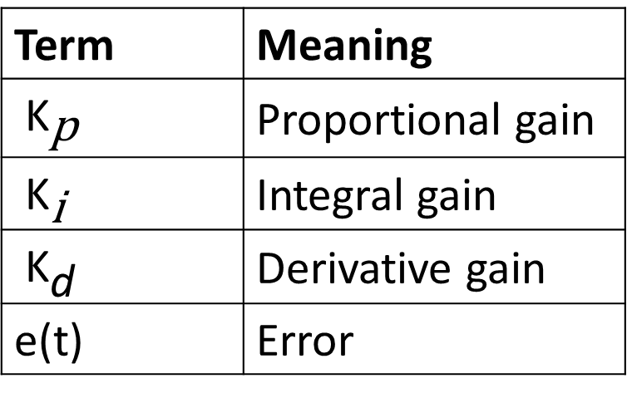
PID Control
PID is a control algorithm that adjusts the motor using three components
Term | Meaning
${\text{K}}_{\text{p}}$ | Proportional gain
${\text{K}}_{\text{i}}$ | Integral gain
${\text{K}}_{\text{d}}$ | Derivative gain
e(t) | Error
Output u(t) becomes the PWM signal

Slide 41
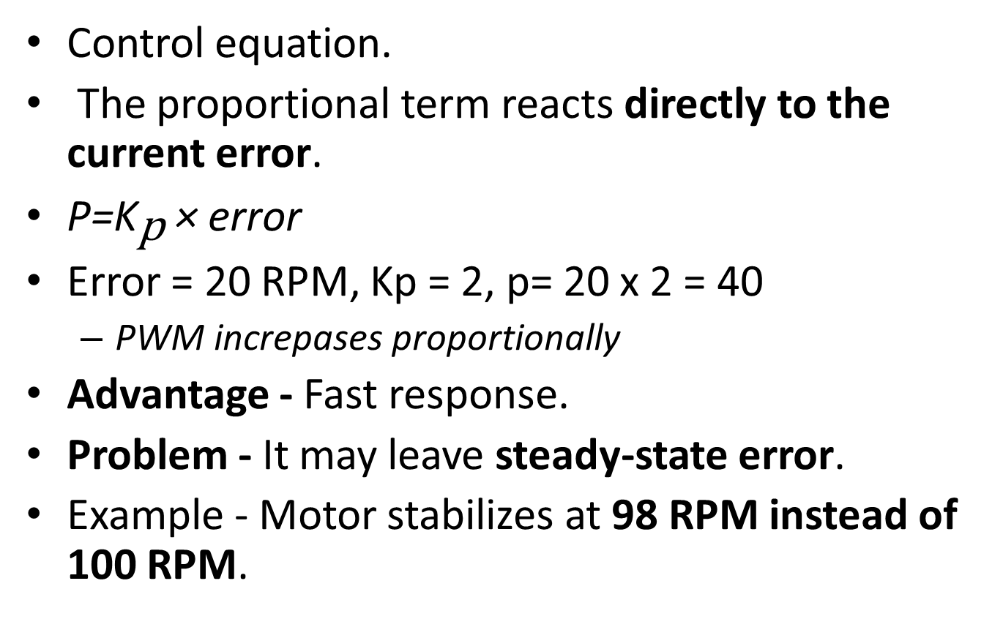
Proportional Control (P)
Control equation.
The proportional term reacts directly to the current error.
P=${\text{K}}_{\text{p}}$​ × error
Error = 20 RPM, Kp = 2, p= 20 x 2 = 40
PWM increpases proportionally
Advantage - Fast response.
Problem - It may leave steady-state error.
Example - Motor stabilizes at 98 RPM instead of 100 RPM.

Slide 42

Integral Control (I)
Integral control corrects accumulated past errors.
It gradually increases control effort if error persists.
Example: If motor runs at 98 RPM for a long time, integral term pushes it to 100 RPM.
Advantage - Eliminates steady-state error.
Problem - Too much integral gain can cause oscillations.

Slide 43

Derivative Control (D)
Derivative control predicts future error based on rate of change.
If error changes quickly, derivative term applies braking action.
Example - If motor speed suddenly jumps above target, derivative reduces PWM quickly.
Advantage - Reduces overshoot.
Problem - Sensitive to sensor noise.

Slide 44
Combined PID Control
Total control signal: PWM=P+I+D
Example: P = 40, I = 10 and D = -5
PWM=45, the Controller sends PWM = 45%.

Slide 45
Practical Robotics Example PID
Consider a mobile robot wheel motor.
Target speed = 120 RPM, Encoder reading = 100 RPM, error = 120-100 = 20RPM
Controller adjusts PWM
Robot reaches stable speed
Step | Speed | PWM
Start | 100 RPM | 40%
Adjust | 110 RPM | 50%
Stabilize | 120 RPM | 52%

Slide 46
PID Control Algorithm (Programming)
Example control loop
error = target_speed - measured_speed
integral = integral + error * dt
derivative = (error - previous_error) / dt
control = Kp*error + Ki*integral + Kd*derivative
pwm = pwm + control
previous_error = error
This loop runs many times per second.

Slide 47
PID in Differential Drive Robots
A robot typically has two motors
Left Wheel ← PID Controller
Right Wheel ← PID Controller
Controller ensures both wheels reach target speeds.
Example:
PID corrects both speeds. This ensures straight motion.
Wheel | Target | Actual
Left | 100 RPM | 95 RPM
Right | 100 RPM | 102 RPM

Slide 48
Benefits of PID in Robotics
PID control enables:
stable motor speed
precise motion
smooth acceleration
accurate turning
reliable navigation
Without PID, robots drift or move unpredictably.

Slide 49
Real Robotics Systems Using PID
PID motor control is used in
industrial robots
autonomous vehicles
drones
mobile robots
robotic arms

Slide 50
Closed-loop motor control
Closed-loop motor control uses feedback from encoders to regulate motor speed.
PID control combines:
Proportional → reacts to current error
Integral → corrects past error
Derivative → predicts future error
Together they allow robots to move accurately and smoothly.

Slide 51
The Programmer's Mental Model of a Motor
YOUR CODE
In robotics applications, bi-directional control of motor speed is necessary.
This requires a Pulse width modulation (PWM) amplifier to be bipolar, allowing for both forward and backward rotations.
DC motors and PWM amplifiers, are the two most important components involved in a robot power train.
Encoder
PWM Amplifier (H-Bridge)
Forward command
Reverse command
Brake command
DC MOTOR
Input: Voltage (via PWM)
Output: Torque + Speed
ENCODER
Output: Position pulses (A, B phases)
YOUR CODE (AGAIN)
Read encoder, compute next command

Slide 52
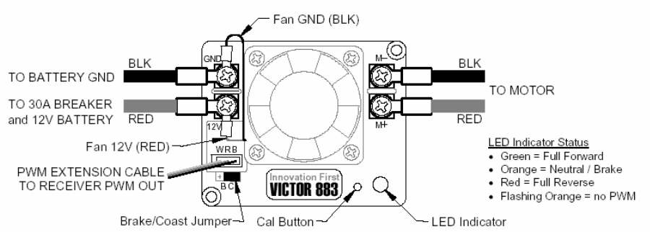
Bipolar PWM amplifier with a built-in cooling fun

Slide 53
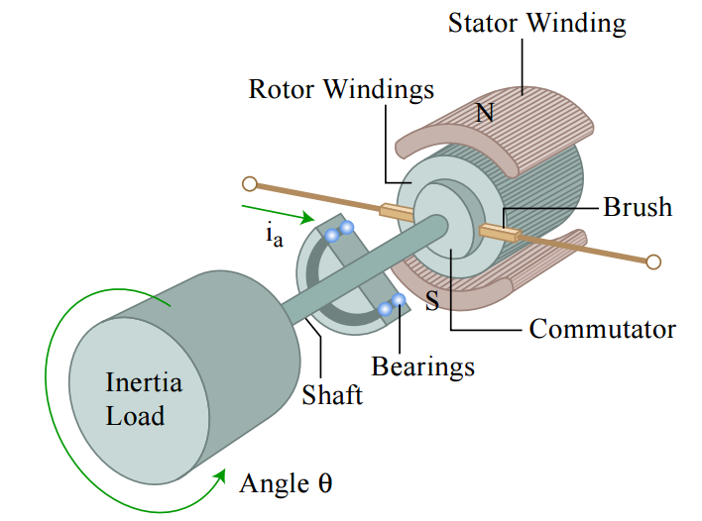
DC Motor
DC servomotor, consisting of a stator, a rotor, and a commutation mechanism
The stator consists of permanent magnets, creating a magnetic field in the air gap between the rotor and the stator.
The rotor has several windings arranged symmetrically around the motor shaft.
As the rotor rotates the polarity of the current flowing to the individual windings is altered. This allows the rotor to rotate continually.

Slide 54
Reflection
Reflect on the application of motors in driving cars, propellers for a drone and propellers for water vehicle

